Slide 1

Lecture 1: Word embeddings:
LSA, Word2Vec, Glove, ELMo
Dr. Reda Bouadjenek
Machine Learning for Decision Support (MLDS)
14 March 2023

Slide 2
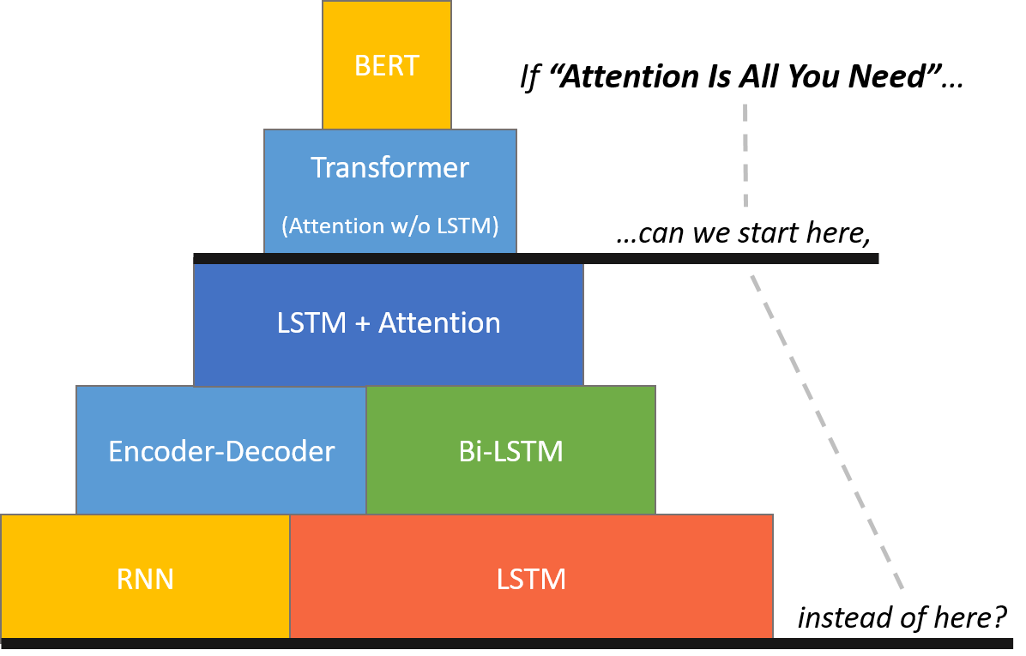
NLP Lectures!
The BERT Mountain!
By Chris McCormick
(Bidirectional Encoder Representations from Transformers)
Word embedding
word2vec
glove

Slide 3
Vector Embedding of Words
Mapping a word to a vector.
  The semantic of the word is embedded in the vector.
Word embeddings depend on a notion of word similarity.
  Similarity is computed using cosine.
A very useful definition is paradigmatic similarity:
  Similar words occur in similar contexts - they are exchangeable.
  POTUS*
  Yesterday The President called a press conference.
  Trump
Transfer learning for text.
  * POTUS: President of the United States.

Slide 4
Word Embedding vs. Bag of Words
Traditional Method - Bag of Words Model
Word Embeddings
Two approaches:
Either uses one hot encoding.
  Each word in the vocabulary is represented by one bit position in a HUGE vector.
  For example, if we have a vocabulary of 10,000 words, and “aardvark” is the 4th word in the dictionary, it would be represented by: [0 0 0 1 0 0 . . . . . . . 0 0 0].
Or uses document representation.
  Each word in the vocabulary is represented by its presence in documents.
  For example, if we have a corpus of 1M documents, and “Hello” is in 1th, 3th and 5th documents only, it would be represented by: [1 0 1 0 1 0 . . . . . . . 0 0 0].
Assumes independence between words.
Stores each word in as a point in space, where it is represented by a dense vector of fixed number of dimensions (generally 300) .
  For example, “Hello” might be represented as : [0.4, -0.11, 0.55, 0.3 . . . 0.1, 0.02].
  Dimensions are projections along different axes, more of a mathematical concept.
Unsupervised, built just by reading huge corpus.
Assumes dependence between words.

Slide 5
Word Embedding vs. Bag of Words
Traditional Method - Bag of Words Model
Word Embeddings
Requires very large weight matrix for 1st layers.
Models not flexible with unseen words in the training set.
A compact weight matrix for 1st layers.
Flexible models with unseen words in the training set.
10,000 words
.
100 units
d300
.
100 units
.
.
W’s size is 10,000x100 = 10⁶
W’s size is 300x100 = 3x10⁴
LM
LM
He
is
a
cultivator
He
is
a
cultivator
≃
farmer

Slide 6
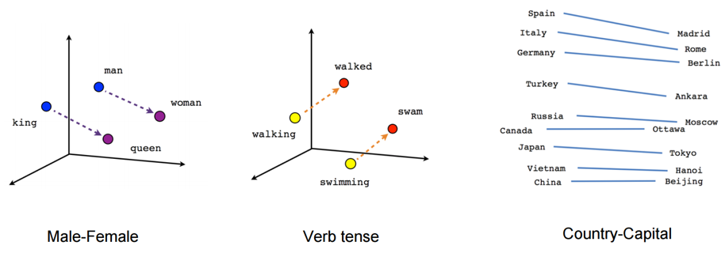
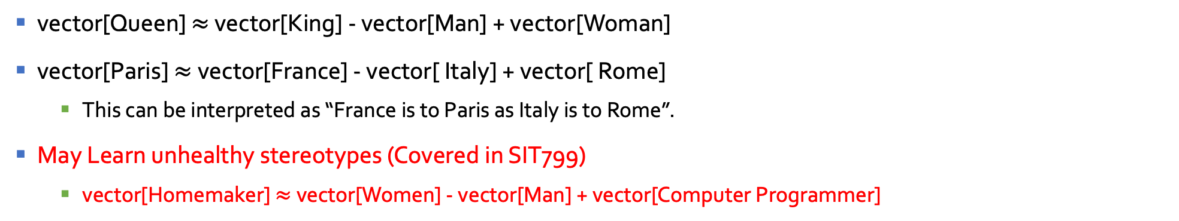
Example 1: Working with vectors
vector[Queen] $≈$ vector[King] - vector[Man] + vector[Woman]
vector[Paris] $≈$vector[France] - vector[ Italy] + vector[ Rome]
  This can be interpreted as “France is to Paris as Italy is to Rome”.
May Learn unhealthy stereotypes (Covered in SIT799)
  vector[Homemaker] $≈$ vector[Women] - vector[Man] + vector[Computer Programmer]

Slide 7
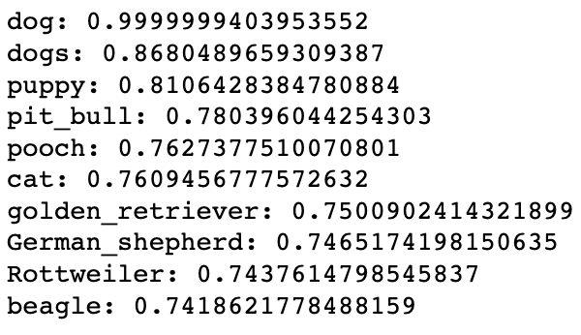
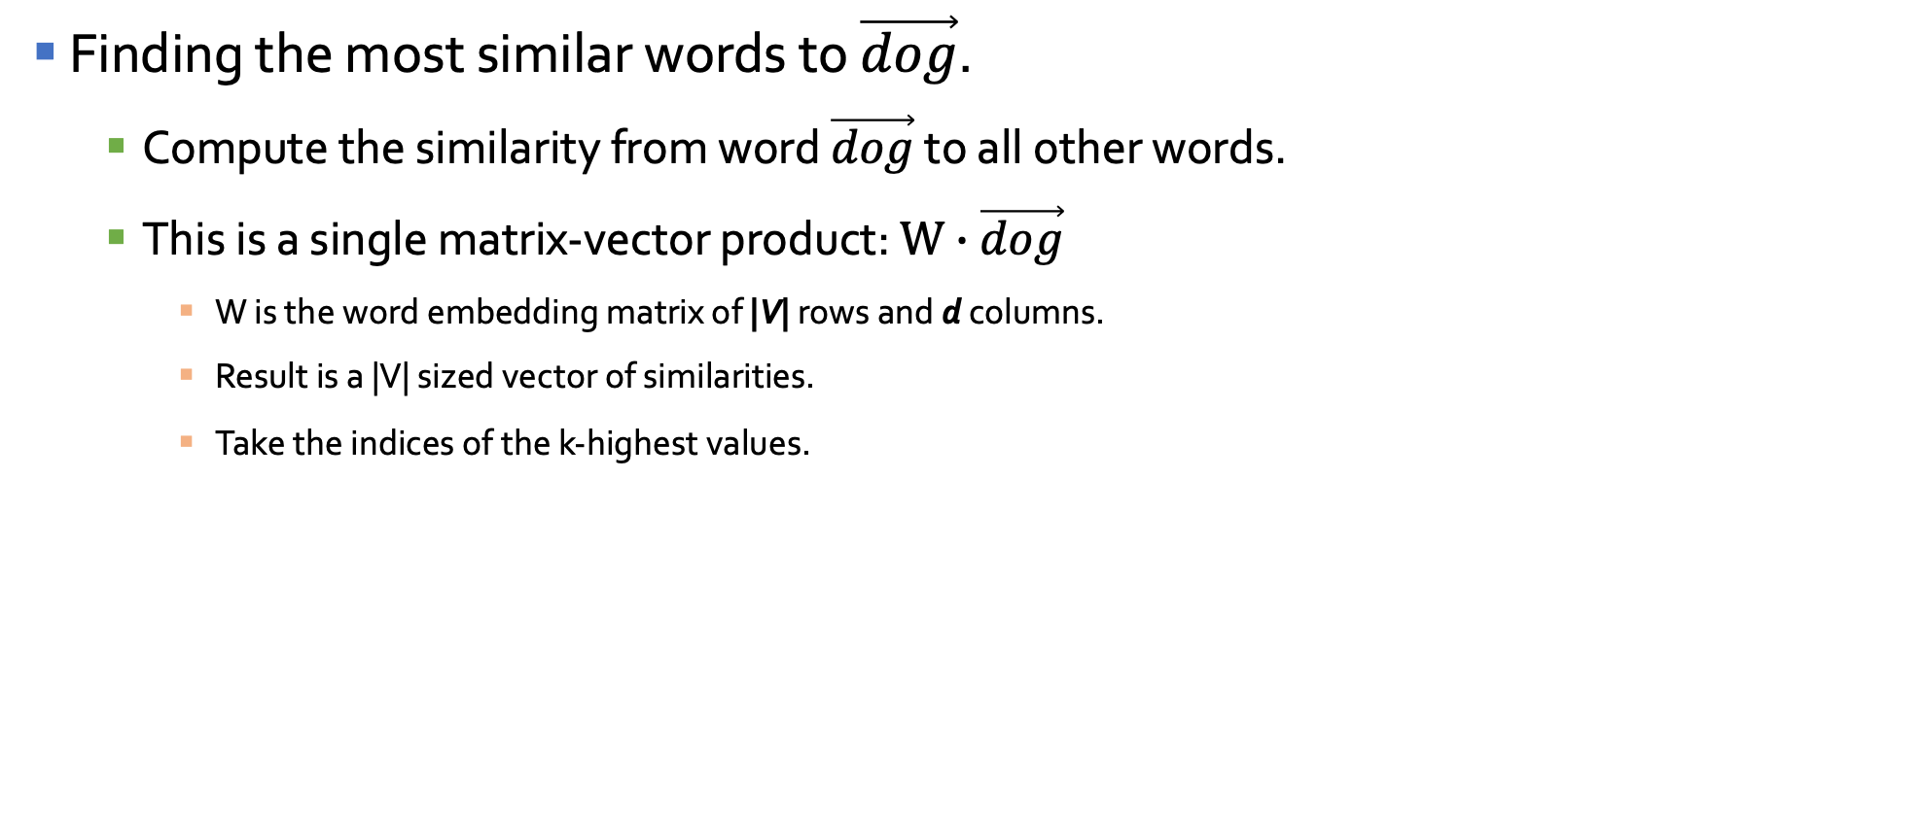
Example 2: Working with vectors
Finding the most similar words to $\vec{dog}$.
  Compute the similarity from word $\vec{dog}$ to all other words.
  This is a single matrix-vector product: $W∙\vec{dog}$
    W is the word embedding matrix of |V| rows and d columns.
    Result is a |V| sized vector of similarities.
    Take the indices of the k-highest values.

Slide 8
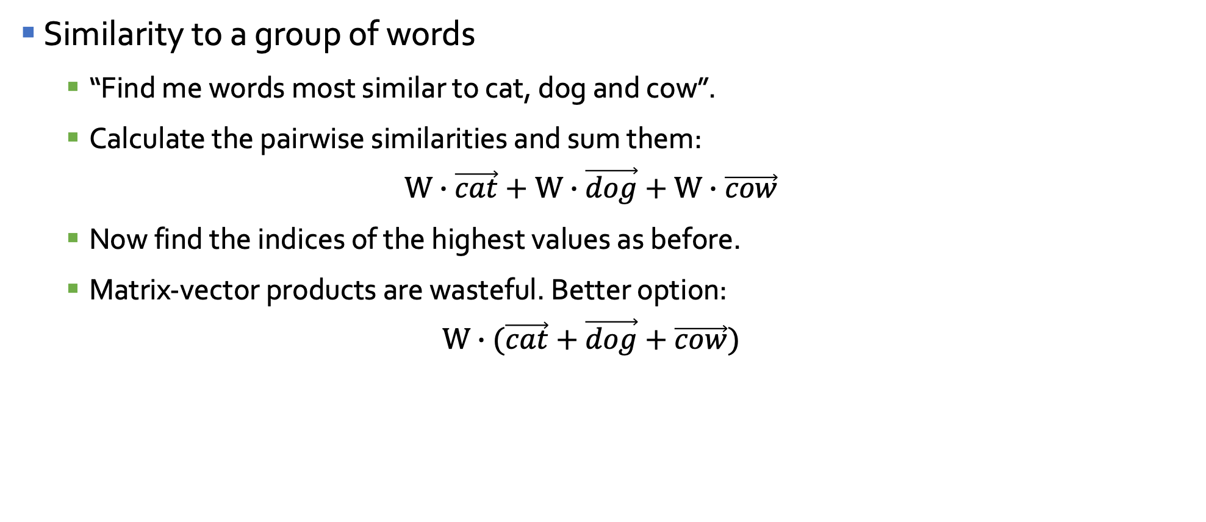
Example 3: Working with vectors
Similarity to a group of words
  “Find me words most similar to cat, dog and cow”.
  Calculate the pairwise similarities and sum them:
  $$W∙\vec{cat}+W∙\vec{dog}+W∙\vec{cow}$$
  Now find the indices of the highest values as before.
  Matrix-vector products are wasteful. Better option:
  $$W∙(\vec{cat}+\vec{dog}+\vec{cow})$$

Slide 9
Applications of Word Vectors
Word Similarity
Machine Translation
Part-of-Speech and Named Entity Recognition
Relation Extraction
Sentiment Analysis
Co-reference Resolution
Clustering
Semantic Analysis of Documents

Slide 10
Vector Embedding of Words
Four main methods described in the talk :
  Latent Semantic Analysis/Indexing (1988)
    Term weighting-based model
    Consider occurrences of terms at document level.
  Word2Vec (2013)
    Prediction-based model.
    Consider occurrences of terms at context level.
  GloVe (2014)
    Count-based model.
    Consider occurrences of terms at context level.
  ELMo (2018)
    Language model-based.
    A different embedding for each word for each task.

Slide 11
Latent Semantic Analysis
Deerwester, Scott, Susan T. Dumais, George W. Furnas, Thomas K. Landauer, and Richard Harshman. "Indexing by latent semantic analysis." Journal of the American society for information science 41, no. 6 (1990): 391-407.

Slide 12

Embedding: Latent Semantic Analysis
Latent semantic analysis studies documents in Bag-Of-Words model (1990).
  i.e. given a matrix A encoding some documents: $A_{ij}$ is the count* of word j in document i. Most entries are 0.
* Often tf-idf or other “squashing” functions of the count are used.
N words
A
M docs

Slide 13

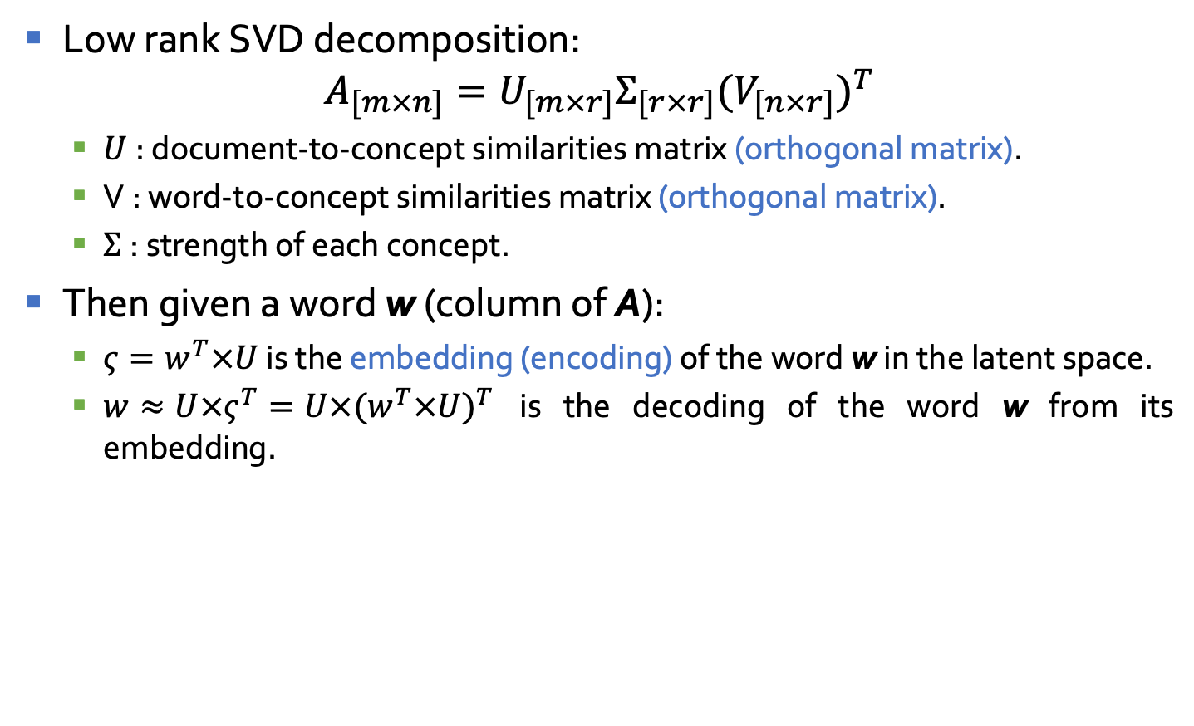
Embedding: Latent Semantic Analysis
Low rank SVD decomposition:
$$A_{[m×n]}=U_{[m×r]}Σ_{[r×r]}{(V_{[n×r]})}^{T}$$
  $U$: document-to-concept similarities matrix (orthogonal matrix).
  V : word-to-concept similarities matrix (orthogonal matrix).
  $Σ$: strength of each concept.
Then given a word w (column of A):
  $ς=w^{T}×U$ is the embedding (encoding) of the word w in the latent space.
  $w≈U×ς^{T}=U×{(w^{T}×U)}^{T}$ is the decoding of the word w from its embedding.
N words
K latent dim
N words
A
U
$$Σ$$
V^{T}
≈
M docs

Slide 14
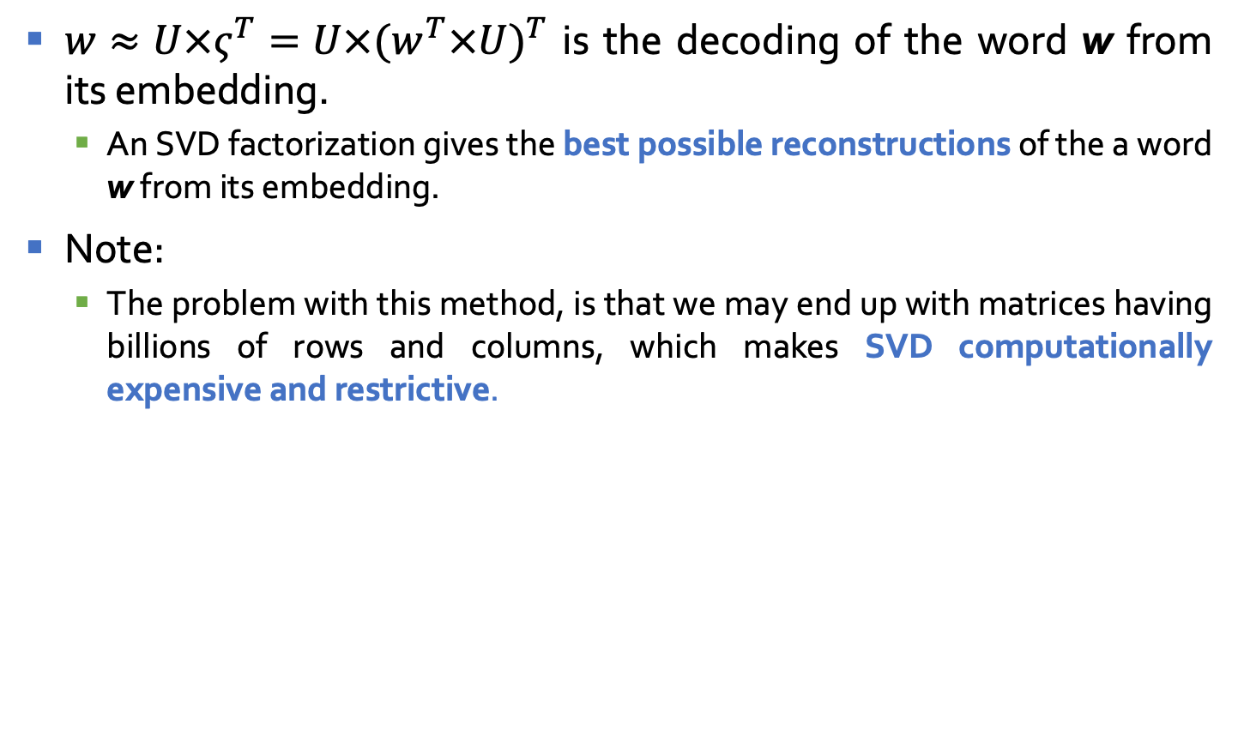
Embedding: Latent Semantic Analysis
$w≈U×ς^{T}=U×{(w^{T}×U)}^{T}$ is the decoding of the word w from its embedding.
  An SVD factorization gives the best possible reconstructions of the a word w from its embedding.
Note:
  The problem with this method, is that we may end up with matrices having billions of rows and columns, which makes SVD computationally expensive and restrictive.
M words
K latent dim
N words
A
U
$$Σ$$
V^{T}
≈
N docs

Slide 15
Word2Vec
Distributed representations of words and phrases and their compositionality.
T Mikolov, I Sutskever, K Chen, GS Corrado, J Dean, NIPS 2013.

Slide 16
word2Vec: Local contexts
Instead of entire documents, Word2Vec uses words k positions away from each center word.
  These words are called context words.
Example for k=3:
  “It was a bright cold day in April, and the clocks were striking”.
  Center word: red (also called focus word).
  Context words: blue (also called target words).
Word2Vec considers all words as center words, and all their context words.

Slide 17
Word2Vec: Data generation (window size = 2)
Example: d1 = “king brave man” , d2 = “queen beautiful women”
word | Word one hot encoding | neighbor | Neighbor one hot encoding
king | [1,0,0,0,0,0] | brave | [0,1,0,0,0,0]
king | [1,0,0,0,0,0] | man | [0,0,1,0,0,0]
brave | [0,1,0,0,0,0] | king | [1,0,0,0,0,0]
brave | [0,1,0,0,0,0] | man | [0,0,1,0,0,0]
man | [0,0,1,0,0,0] | king | [1,0,0,0,0,0]
man | [0,0,1,0,0,0] | brave | [0,1,0,0,0,0]
queen | [0,0,0,1,0,0] | beautiful | [0,0,0,0,1,0]
queen | [0,0,0,1,0,0] | women | [0,0,0,0,0,1]
beautiful | [0,0,0,0,1,0] | queen | [0,0,0,1,0,0]
beautiful | [0,0,0,0,1,0] | women | [0,0,0,0,0,1]
woman | [0,0,0,0,0,1] | queen | [0,0,0,1,0,0]
woman | [0,0,0,0,0,1] | beautiful | [0,0,0,0,1,0]

Slide 18
Word2Vec: Data generation (window size = 2)
Example: d1 = “king brave man” , d2 = “queen beautiful women”
word | Word one hot encoding | neighbor | Neighbor one hot encoding
king | [1,0,0,0,0,0] | brave | [0,1,1,0,0,0]
 |  | man
brave | [0,1,0,0,0,0] | king | [1,0,1,0,0,0]
 |  | man
man | [0,0,1,0,0,0] | king | [1,1,0,0,0,0]
 |  | brave
queen | [0,0,0,1,0,0] | beautiful | [0,0,0,0,1,1]
 |  | women
beautiful | [0,0,0,0,1,0] | queen | [0,0,0,1,0,1]
 |  | women
woman | [0,0,0,0,0,1] | queen | [0,0,0,1,1,0]
 |  | beautiful

Slide 19
Word2Vec: main context representation models
Continuous Bag of Words
(CBOW)
Skip-Ngram
Input
Output
W₋₂
W₋₂
W₋₁
Output
Input
W₋₁
Sum and projection
Projection
Over sum
w₀
w₀
w₁
w₁
w₂
w₂
Word2Vec is a predictive model.
Will focus on Skip-Ngram model

Slide 20
Word2Vec : Neural Network representation
Input layer (focus word)
Hidden layer
Output (context using softmax)
|V_{w}|
|V_{c}|
w1
w2

Slide 21
Word2Vec : Neural Network representation
Input layer (focus word)
Hidden layer
Output (context using softmax)
king
1
0
|V_{w}|
|V_{c}|
0
0.5
brave
0
w1
0.5
man
0
w2
0
0
0
0
0

Slide 22
Word2Vec : Neural Network representation
Input layer (focus word)
Hidden layer
Output (context using softmax)
0
0.5
king
|V_{w}|
|V_{c}|
brave
1
0
0
w1
0.5
man
0
w2
0
0
0
0
0

Slide 23
Word2Vec : Neural Network representation
Input layer (focus word)
Hidden layer
Output (context using softmax)
0
0.5
king
|V_{w}|
|V_{c}|
0
0.5
brave
man
1
w1
0
0
w2
0
0
0
0
0

Slide 24
Word2Vec : Neural Network representation
Input layer (focus word)
Hidden layer
Output (context using softmax)
0
0
|V_{w}|
|V_{c}|
0
0
0
w1
0
queen
1
w2
0
0
0.5
beautiful
0
0.5
women

Slide 25
Word2Vec : Neural Network representation
Input layer (focus word)
Hidden layer
Output (context using softmax)
0
0
|V_{w}|
|V_{c}|
0
0
0
w1
0
0
w2
0.5
queen
beautiful
1
0
0
0.5
women

Slide 26
Word2Vec : Neural Network representation
Input layer (focus word)
Hidden layer
Output (context using softmax)
0
0
|V_{w}|
|V_{c}|
0
0
0
w1
0
0
w2
0.5
queen
0
0.5
beautiful
women
1
0

Slide 27
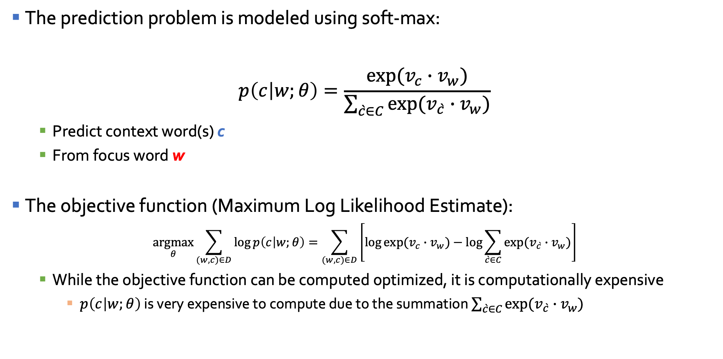
Skip-Ngram: Training method
The prediction problem is modeled using soft-max:
$$p\left(c | w;θ\right)=\frac{exp⁡(v_{c}∙v_{w})}{\sum_{\grave{c}∈C}{exp⁡(v_{\grave{c}}∙v_{w})}}$$
  Predict context word(s) c
  From focus word w
The objective function (Maximum Log Likelihood Estimate):
$$\underset{θ}{argmax}{\sum_{(w,c)∈D}{\log{p\left(c | w;θ\right)}}=\sum_{(w,c)∈D}{\left[\log{exp⁡(v_{c}∙v_{w})}−\log{\sum_{\grave{c}∈C}{exp⁡(v_{\grave{c}}∙v_{w})}}\right]}}$$
  While the objective function can be computed optimized, it is computationally expensive
    $p\left(c | w;θ\right)$ is very expensive to compute due to the summation $\sum_{\grave{c}∈C}{exp⁡(v_{\grave{c}}∙v_{w})}$

Slide 28
Defining a new learning problem: Binary classification
Example:
  “king brave man”
K = 5 to 20 for small collections.
K= 2 to 5 for large collections.
Context word | Focus word | target
brave | king | 1
juice | king | 0
orange | king | 0
mac | king | 0
computer | king | 0
java | king | 0
k

Slide 29
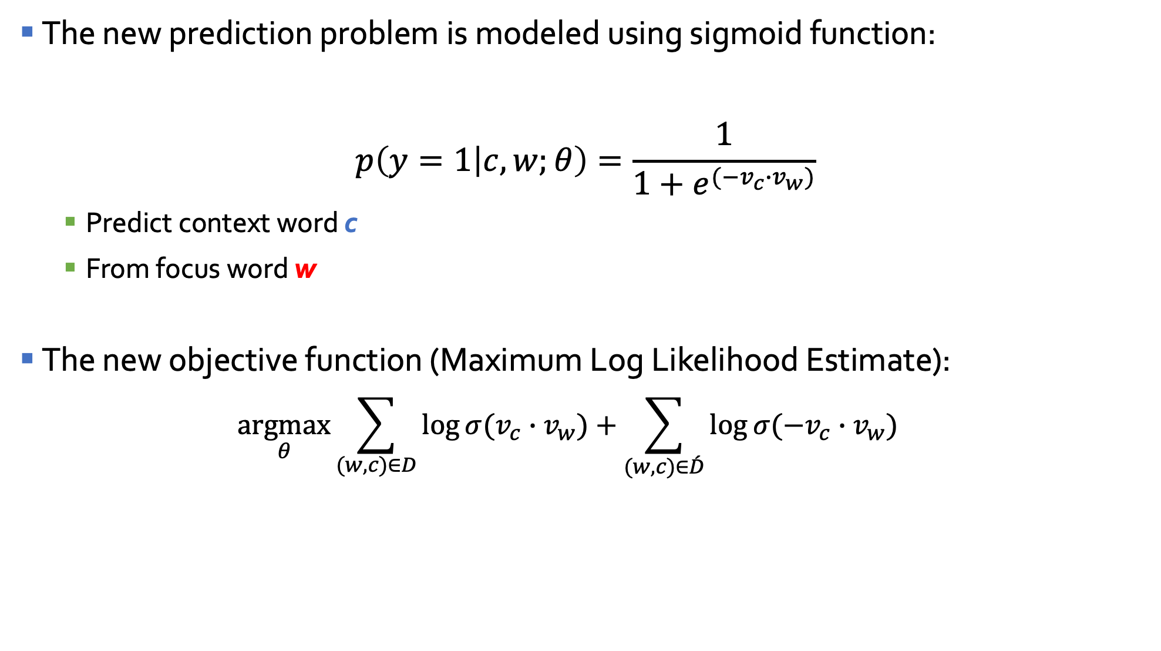
Defining a new learning problem
The new prediction problem is modeled using sigmoid function:
$$p\left(y=1 | c,w;θ\right)=\frac{1}{1+e^{(−v_{c}∙v_{w})}}$$
  Predict context word c
  From focus word w
The new objective function (Maximum Log Likelihood Estimate):
  $$\underset{θ}{argmax}{\sum_{(w,c)∈D}{\log{⁡σ(v_{c}∙v_{w})}+\sum_{(w,c)∈\acute{D}}{\log{⁡σ(−v_{c}∙v_{w})}}}}$$

Slide 30
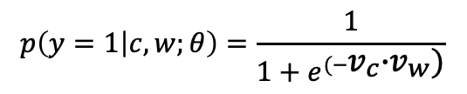
Negative sampling : Neural Network representation
Input layer (focus word)
Input layer (context word)
king
1
0
0
0
0
0
0
0
brave
0
0
0
0
0
1
0
0
|V_{w}|
|V_{c}|
y?
$$p\left(y=1 | c,w;θ\right)=\frac{1}{1+e^{(−v_{c}∙v_{w})}}$$

Slide 31
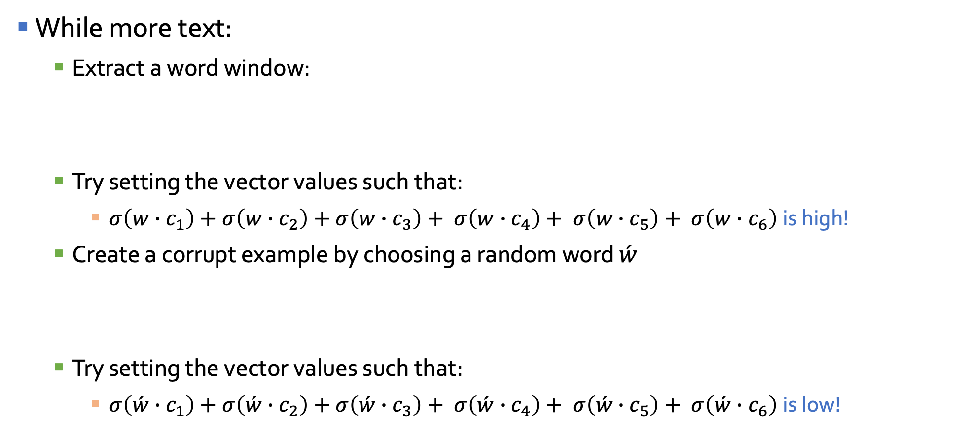
Skip-Ngram: Example
While more text:
  Extract a word window:
  Try setting the vector values such that:
    $σ\left(w∙c_{1}\right)+σ\left(w∙c_{2}\right)+σ\left(w∙c_{3}\right)+ σ\left(w∙c_{4}\right)+ σ\left(w∙c_{5}\right)+ σ\left(w∙c_{6}\right)$is high!
  Create a corrupt example by choosing a random word $\acute{w}$
  Try setting the vector values such that:
    $σ\left(\acute{w}∙c_{1}\right)+σ\left(\acute{w}∙c_{2}\right)+σ\left(\acute{w}∙c_{3}\right)+ σ\left(\acute{w}∙c_{4}\right)+ σ\left(\acute{w}∙c_{5}\right)+ σ\left(\acute{w}∙c_{6}\right)$is low!

Slide 32
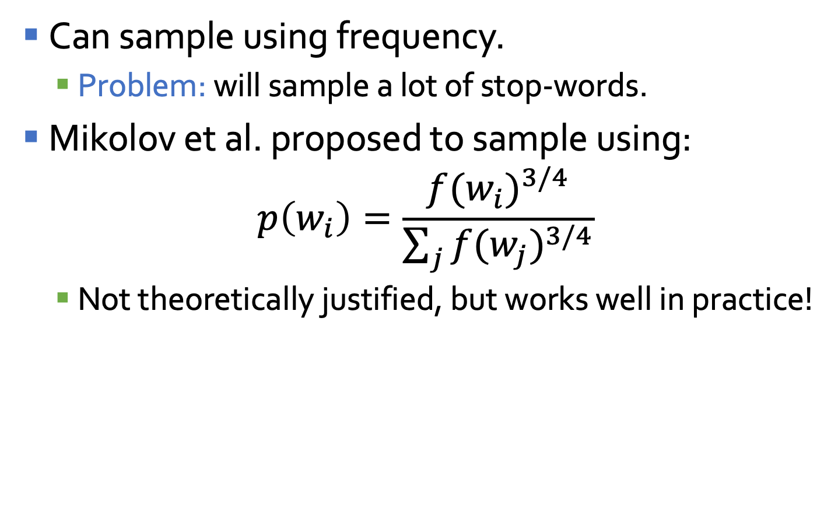
Skip-Ngram: How to select negative samples?
Can sample using frequency.
  Problem: will sample a lot of stop-words.
Mikolov et al. proposed to sample using:
$$p\left(w_{i}\right)=\frac{{f(w_{i})}^{3/4}}{\sum_{j}{{f(w_{j})}^{3/4}}}$$
  Not theoretically justified, but works well in practice!

Slide 33
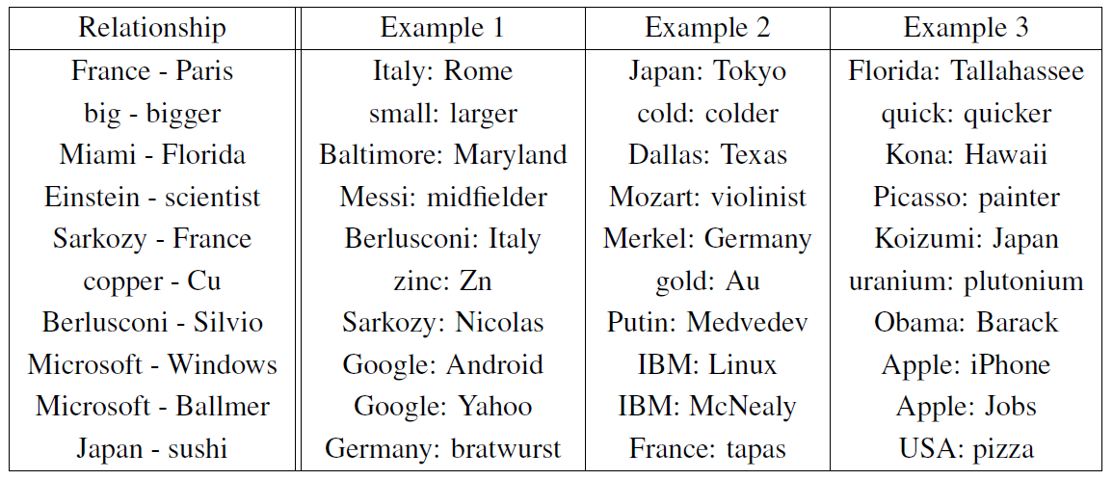
Relations Learned by Word2Vec
A relation is defined by the vector displacement in the first column. For each start word in the other column, the closest displaced word is shown.
“Efficient Estimation of Word Representations in Vector Space” Tomas Mikolov, Kai Chen, Greg Corrado, Jeffrey Dean, Arxiv 2013

Slide 34
GloVe: Global Vectors for Word Representation
Jeffrey Pennington, Richard Socher, and Christopher D. Manning. 2014.
GloVe: Global Vectors for Word Representation.

Slide 35


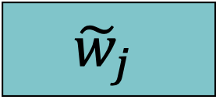
GloVe: Global Vectors for Word Representation
While word2Vec is a predictive model — learning vectors to improve the predictive ability, GloVe is a count-based model.
Count-based models learn vectors by doing dimensionality reduction on a co-occurrence counts matrix.
  Factorize this matrix to yield a lower-dimensional matrix of words and features, where each row yields a vector representation for each word.
N words
K latent dim
N words
$$\log{X_{i,j}}$$
$$w_{i}^{T}$$
K latent
dim
$${\tilde{w}}_{j}$$
≈
N words

Slide 36

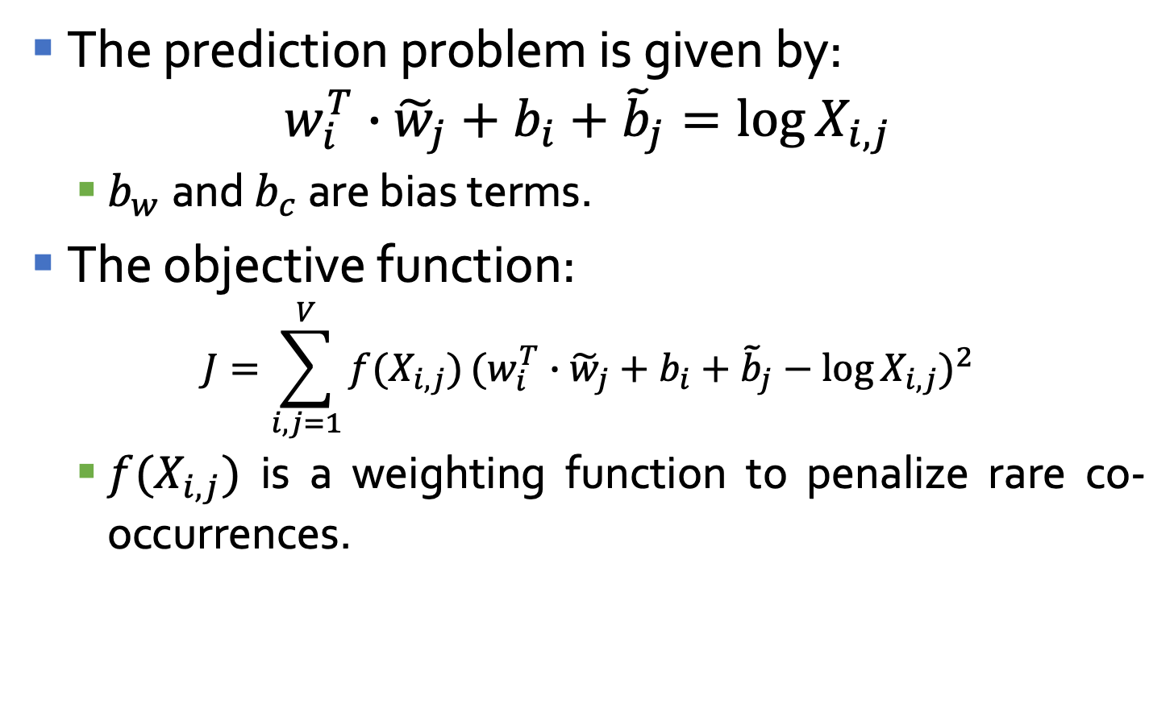

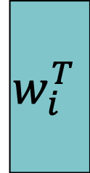
GloVe: Training
The prediction problem is given by:
$$w_{i}^{T}∙{\tilde{w}}_{j}+b_{i}+{\tilde{b}}_{j}=\log{X_{i,j}}$$
  $b_{w}$ and $b_{c}$ are bias terms.
The objective function:
$$J=\sum_{i,j=1}^{V}{f(X_{i,j})}{(w_{i}^{T}∙{\tilde{w}}_{j}+b_{i}+{\tilde{b}}_{j}−\log{X_{i,j}})}^{2}$$
  $f(X_{i,j})$ is a weighting function to penalize rare co-occurrences.
N words
K latent dim
N words
$$\log{X_{i,j}}$$
$$w_{i}^{T}$$
K latent
dim
$${\tilde{w}}_{j}$$
≈
N words

Slide 37

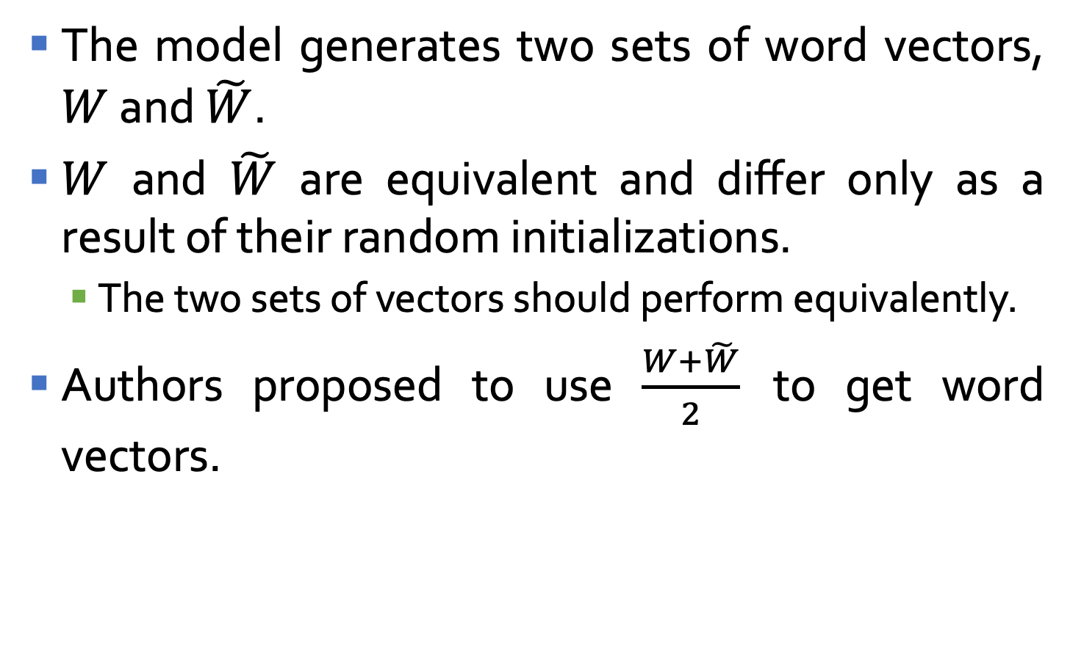

GloVe: Training
The model generates two sets of word vectors, $W$ and $\tilde{W}$.
$W$ and $\tilde{W}$ are equivalent and differ only as a result of their random initializations.
  The two sets of vectors should perform equivalently.
Authors proposed to use $\frac{W+\tilde{W}}{2}$ to get word vectors.
$$w_{i}^{T}$$
$${\tilde{w}}_{j}$$
2

Slide 38
ELMo: Embeddings from Language Models representations
Slides by Alex Olson
Matthew E. Peters, Mark Neumann, Mohit Iyyer, Matt Gardner, Christopher Clark, Kenton Lee, Luke Zettlemoyer.
Deep contextualized word representations, 2018

Slide 39
Context is a key
Language is complex, and context can completely change the meaning of a word in a sentence.
Example:
  I let the kids outside to play.
  He had never acted in a more famous play before.
  It wasn’t a play the coach would approve of.
Need a model which captures the different nuances of the meaning of words given the surrounding text.

Slide 40
Different senses for different tasks
Previous models (GloVe, Vord2Vec, etc.) only have one representation per word
  They can’t capture these ambiguities.
When you only have one representation, all levels of meaning are combined.
Solution: have multiple levels of understanding.
  ELMo: Embeddings from Language Model representations.

Slide 41
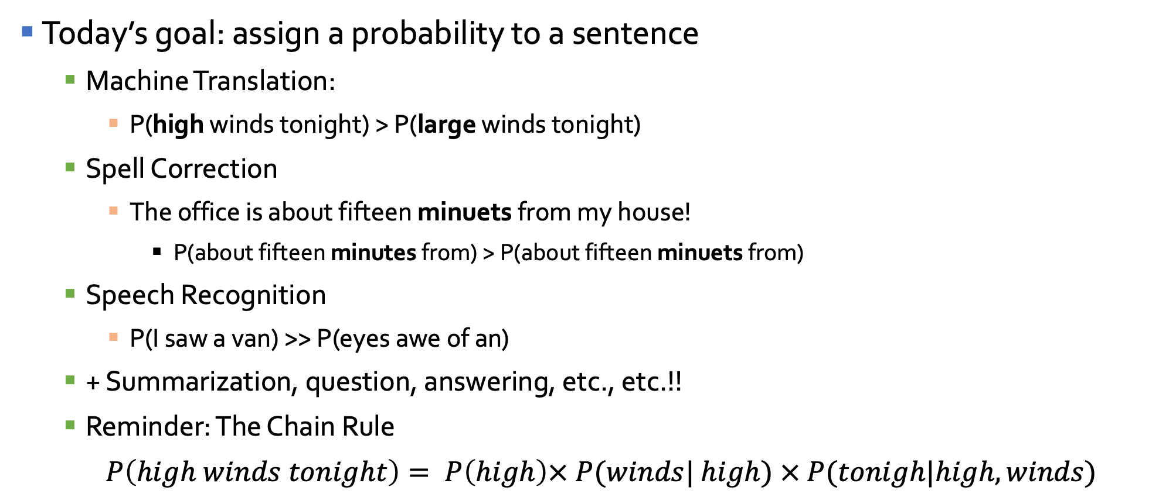
What is language modelling?
Today’s goal: assign a probability to a sentence
  Machine Translation:
    P(high winds tonight) > P(large winds tonight)
  Spell Correction
    The office is about fifteen minuets from my house!
      P(about fifteen minutes from) > P(about fifteen minuets from)
  Speech Recognition
    P(I saw a van) >> P(eyes awe of an)
  + Summarization, question, answering, etc., etc.!!
  Reminder: The Chain Rule
  $P\left(high winds tonight\right)= P\left(high\right)× P(winds| high) × P(tonigh|high,winds)$

Slide 42






RNN Language Model
P(a), p(aaron), …, p(cats), p(zulu)
P(average|cats)
P(15|cats,average)
P(<EOS>|…)
$${\hat{y}}^{<1>}$$
$${\hat{y}}^{<2>}$$
$${\hat{y}}^{<3>}$$
$${\hat{y}}^{<9>}$$
a^{<1>}
a^{<2>}
a^{<3>}
a^{<9>}
a^{<0>}=$\vec{0}$
…
W
W
W
W
x^{<0>}=$\vec{0}$
x^{<2>}=y^{<1>}
cats
x^{<3>}=y^{<2>}
average
x^{<9>}=y^{<8>}
day
Cats average 15 hours of sleep a day. <EOS>
  P(sentence) = P(cats)P(average|cats)P(15|cats,average)…

Slide 43
Embeddings from Language Models
ELMo architecture trains a language model using a 2-layer bi-directional LSTM (biLMs)
What input?
  Traditional Neural Language Models use fixed -length word embedding.
    One-hone encoding.
    Word2Vec.
    Glove.
    Etc.…
  ELMo uses a more complex representation.

Slide 44
ELMo: What input?
Transformations applied for each token before being provided to input of first LSTM layer.
Pros of character embeddings:
  It allows to pick up on morphological features that word-level embeddings could miss.
  It ensures a valid representation even for out-of-vocabulary words.
  It allows us to pick up on n-gram features that build more powerful representations.
  The highway network layers allow for smoother information transfer through the input.

Slide 45
ELMo: Embeddings from Language Models
Intermediate representation
(output vector)
An example of combining the bidirectional hidden representations and word representation for "happy" to get an ELMo-specific representation. Note: here we omit visually showing the complex network for extracting the word representation that we described in the previous slide.

Slide 46
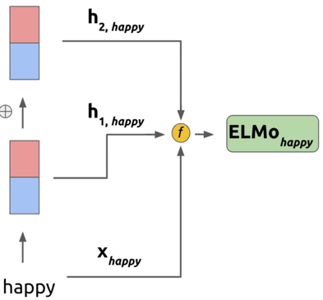
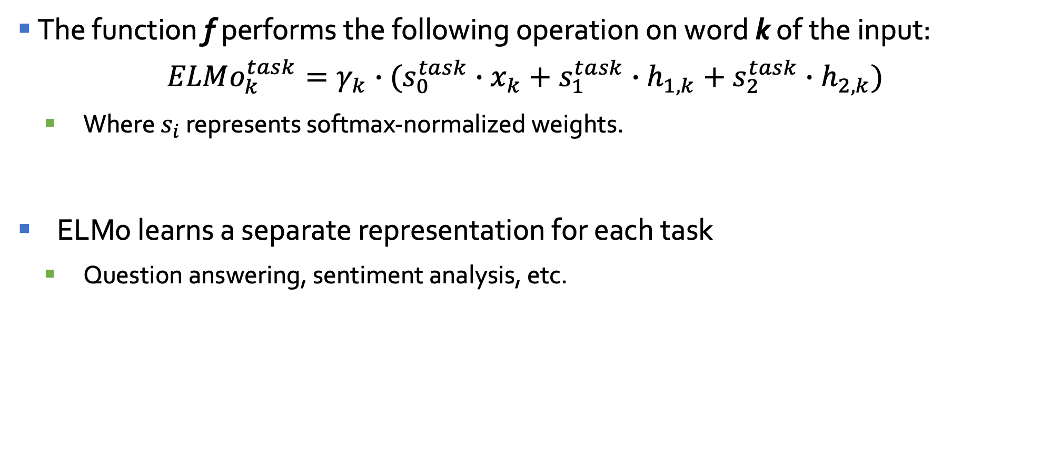
ELMo mathematical details
The function f performs the following operation on word k of the input:
$$ELMo_{k}^{task}=γ_{k}∙(s_{0}^{task}∙x_{k}+s_{1}^{task}∙h_{1,k}+s_{2}^{task}∙h_{2,k})$$
  Where $s_{i}$​ represents softmax-normalized weights.
ELMo learns a separate representation for each task
  Question answering, sentiment analysis, etc.

Slide 47
Difference to other methods
 | Source | Nearest Neighbors
GloVe | play | playing, game, games, played, players, plays, player, Play, football, multiplayer
biLM | Chico Ruiz made a spectacular play on Alusik ’s grounder {. . . } | Kieffer , the only junior in the group , was commended for his ability to hit in the clutch , as well as his all-round excellent play .
 | Olivia De Havilland signed to do a Broadway play for Garson {. . . } | {. . . } they were actors who had been handed fat roles in a successful play , and had talent enough to fill the roles competently , with nice understatement .
Nearest neighbors words to “play” using GloVe and the nearest neighbor sentences to “play” using ELMo.

Slide 48
Bibliography
Mikolov, Tomas, et al. ”Efficient estimation of word representations in vector space.” arXiv preprint arXiv:1301.3781 (2013).
Kottur, Satwik, et al. ”Visual Word2Vec (vis-w2v): Learning Visually Grounded Word Embeddings Using Abstract Scenes.” arXiv preprint arXiv:1511.07067 (2015).
Lazaridou, Angeliki, Nghia The Pham, and Marco Baroni. ”Combining language and vision with a multimodal skip-gram model.” arXiv preprint arXiv:1501.02598 (2015).
Rong, Xin. ”word2vec parameter learning explained.” arXiv preprint arXiv:1411.2738 (2014).
Mikolov, Tomas, et al. ”Distributed representations of words and phrases and their compositionality.” Advances in neural information processing systems. 2013.
Jeffrey Pennington, Richard Socher, and Christopher D. Manning. 2014. GloVe: Global Vectors for Word Representation.
Scott Deerwester et al. “Indexing by latent semantic analysis”. Journal of the American society for information science (1990).
Matthew E. Peters, Mark Neumann, Mohit Iyyer, Matt Gardner, Christopher Clark, Kenton Lee, Luke Zettlemoyer.
Matt Gardner and Joel Grus and Mark Neumann and Oyvind Tafjord and Pradeep Dasigi and Nelson F. Liu and Matthew Peters and Michael Schmitz and Luke S. Zettlemoyer. AllenNLP: A Deep Semantic Natural Language Processing Platform.

