Slide 1
Lecture 3:
BERT: Bidirectional Encoder Representations from Transformers
Dr. Mohamed Reda Bouadjenek
School of Information Technology, Faculty of Sci Eng & Built Env
reda.bouadjenek@deakin.edu.au
June 10, 2020

Slide 2
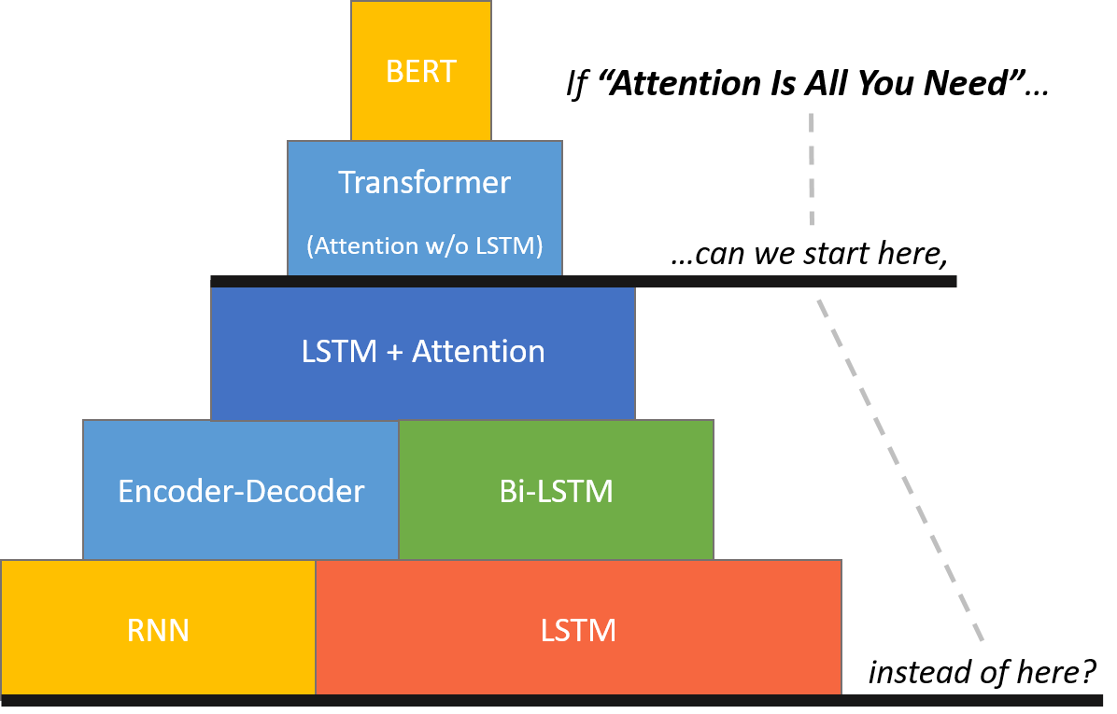
NLP Lectures!
The BERT Mountain!
By Chris McCormick
(Bidirectional Encoder Representations from Transformers)

Slide 3
Outline
Quick Recap: Transformers (previous talk!)
BERT
  Architecture
  Input Representation
  Pre-training procedure: Masked LM and Next Sentence Prediction
  Fine-tuning procedure
Experiments
Conclusions

Slide 4
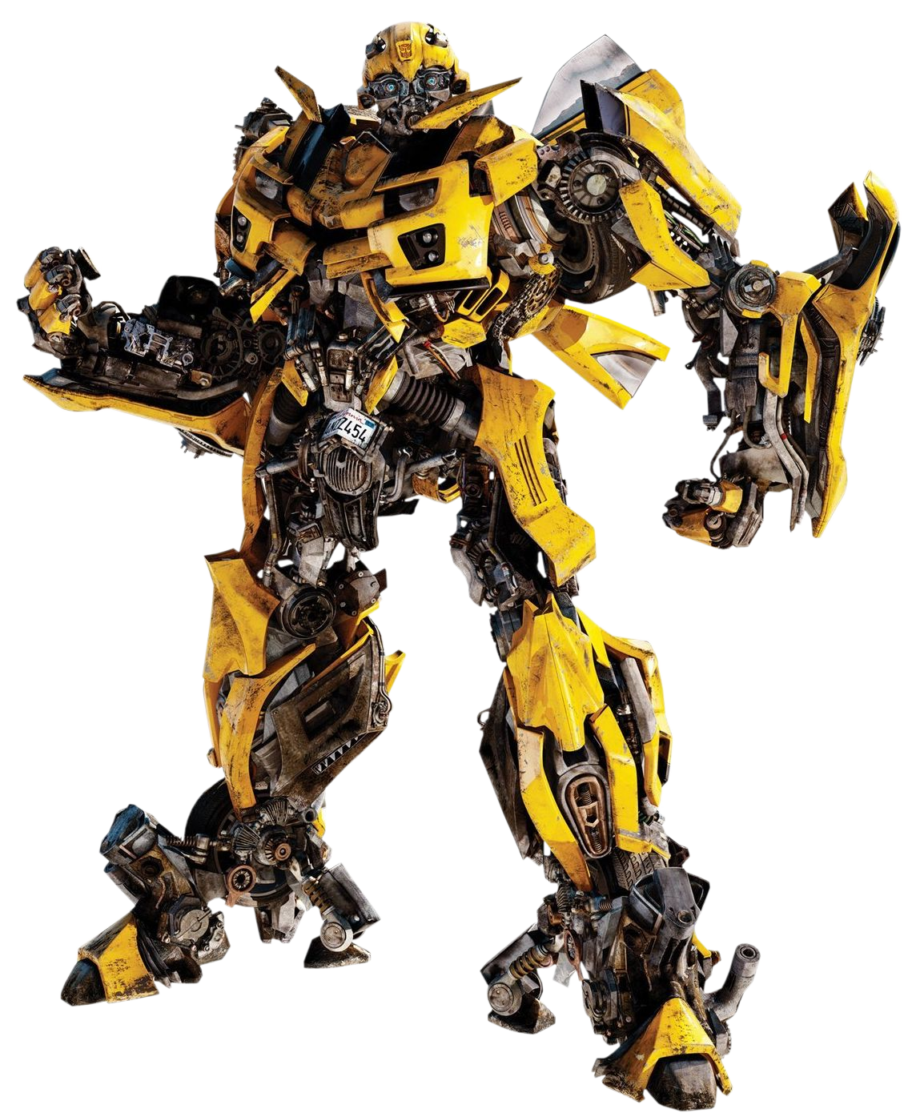
Quick Recap: Transformers
Ashish Vaswani et. Attention Is All You Need.
NIPS 2017.

Slide 5
Encoder-Decoder
Ashish Vaswani et. Attention Is All You Need.
NIPS 2017.

Slide 6
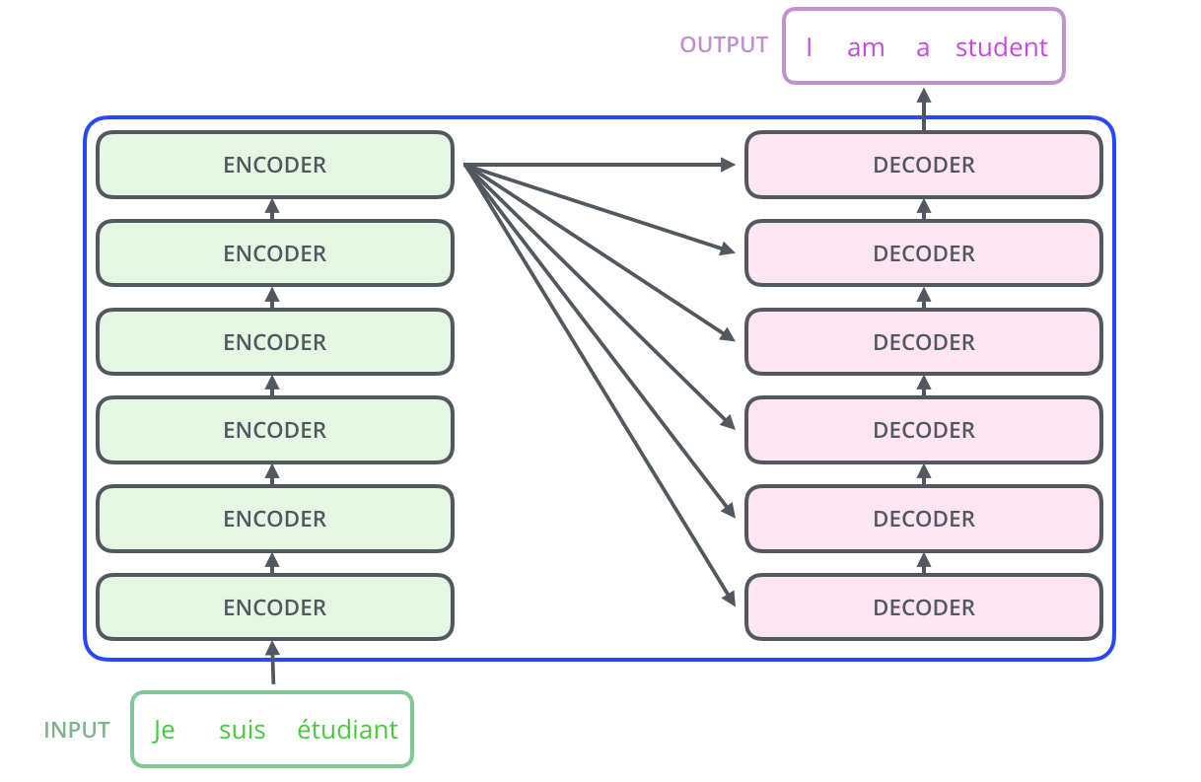
Encoder-Decoder
Figure by: Jay Alammar
The Illustrated Transformer
http://jalammar.github.io/illustrated-transformer/

Slide 7
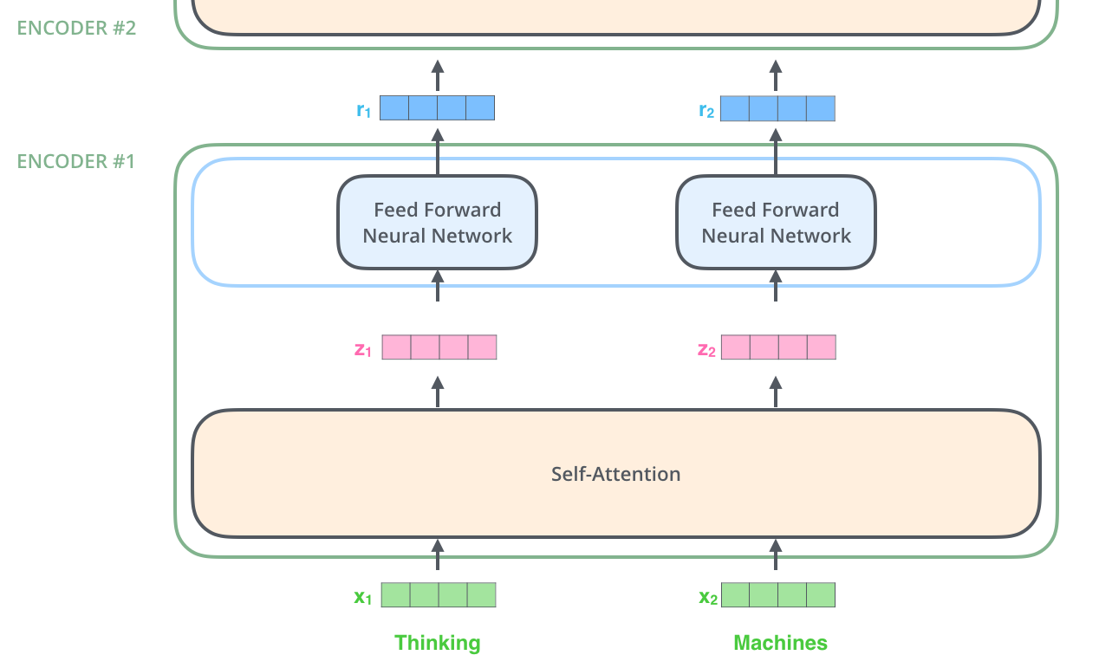
Encoder
Figure by: Jay Alammar
The Illustrated Transformer
http://jalammar.github.io/illustrated-transformer/
Note: The FFNN is independent
for each word.
Hence can be parallelized.

Slide 8

Self-Attention Mechanism
All-to-all comparison.
  Each layer is $O(N^{2})$ for sequence of length N - self attention.
Every output is a weighted sum of every input.
  The weighting is a function to learn.

Slide 9
Multi-Headed Attention
Clever, important innovation.
  Not that hard.
Just do that same thing 8 times with different Q,K,V matrices.
Let the network learn 8 different semantic meanings of attention.
  E.g., One grammar, one for vocabulary, one for conjugation, etc.
  Very flexible mechanism for sequence processing.

Slide 10
Position encoding
Figure by: Jay Alammar
The Illustrated Transformer
http://jalammar.github.io/illustrated-transformer/

Slide 11
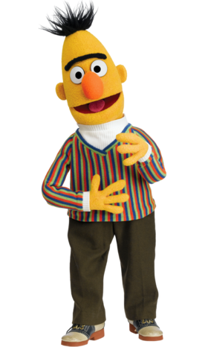
BERT
Bidirectional Encoder Representations from Transformers

Slide 12
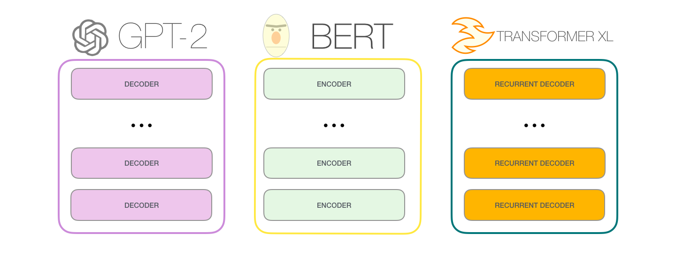
Model architecture
Transformers is an Encoder-Decoder architecture
  A transformer uses Encoder stack to model input, and uses Decoder stack to model output (using input information from encoder side).
BERT
  If we are only interested in training a language model for the input for some other tasks, then we do not need the Decoder of the transformer, that gives us BERT.

Slide 13
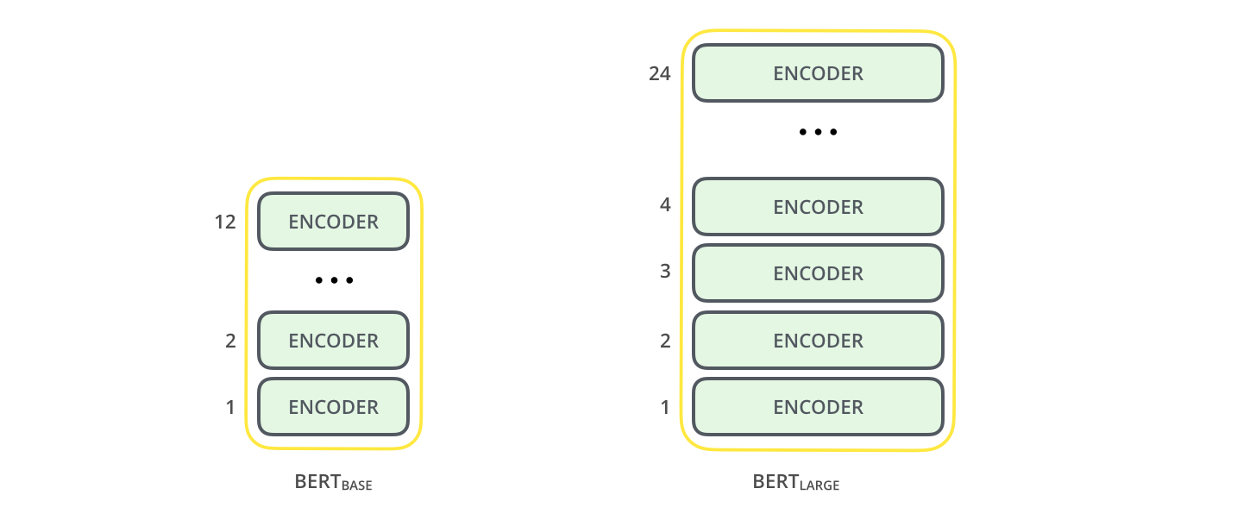
Model architecture
Two models with different sizes were investigated
  BERT_{BASE} : L=12, H=768, A=12, Total Parameters=110M
  BERT_{LARGE}: L=24, H=1024, A=16, Total Parameters=340M
    L: number of layers (Transformer blocks), H: the hidden size, A: the number of self-attention heads.
    Cased and uncased versions.
    Multiple-languages.
  Also available: BERT_{Tiny} , BERT_{Mini} , BERT_{Small}, BERT_{Medium}

Slide 14
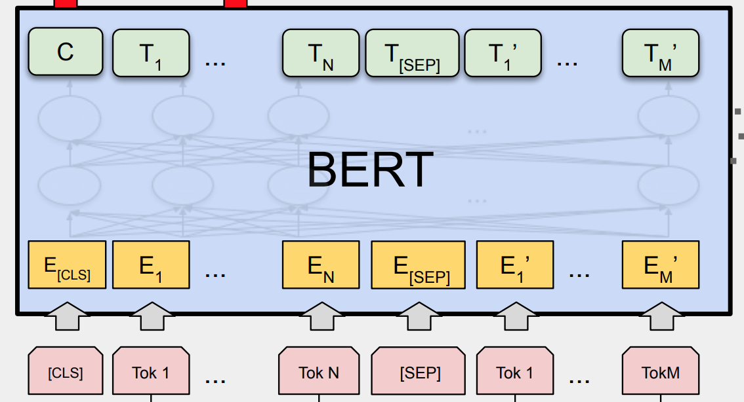
BERT in Action

Slide 15
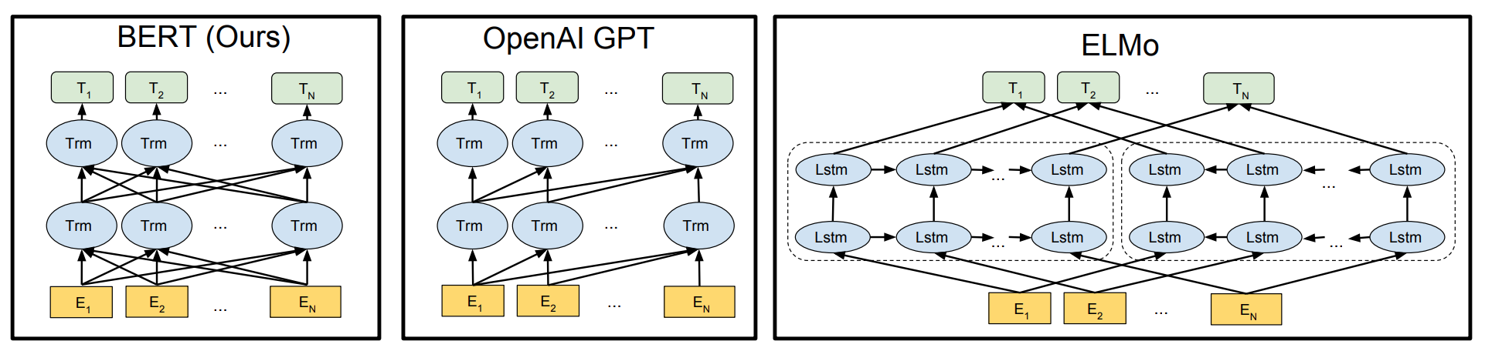
Differences in pre-training model architectures: BERT, OpenAI GPT, and ELMo
GPT is built using transformer decoder blocks. BERT, on the other hand, uses transformer encoder blocks.
GPT is auto-regressive in nature. BERT is not.
  In losing auto-regression, BERT gained the ability to incorporate the context on both sides of a word to gain better results.

Slide 16
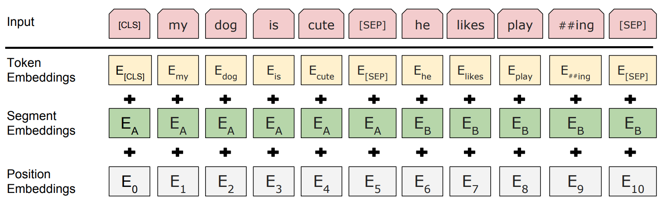
Input Representation
Token Embeddings: Use pretrained WordPiece embeddings.
Segment Embeddings (Optional): Added sentence embedding to every tokens of each sentence.
Position Embeddings: Use learned Position Embeddings.
Use [CLS] for the classification tasks.
Separate sentences by using a special token [SEP].

Slide 17
BERT’s Vocabulary
BERT is pre-trained ➔ Vocabulary is fixed
  The vocabulary contains 30,522 tokens.
  How to deal with unknown words?
Break down unknown words into subwords:
  Using the wordpiece model.
A subword exists for every character.
  2 types of subwords
    All subwords start with “##”…
    Except for the first subword in a word
embedding
em
##bed
##ding
kroxldyphivc
k
##ro
##x
##ld
##yp
##ro
##x

Slide 18
Pre-training
Task#1: Masked LM
15% of the words are masked at random, and the task is to predict the masked words based on its left and right context.
Not all tokens were masked in the same way
  Example: “My dog is hairy”)
    80% were replaced by the <MASK> token: “My dog is <MASK>”
    10% were replaced by a random token: “My dog is apple”
    10% were left intact: “My dog is hairy”

Slide 19
Pre-training
Task#2: Next Sentence Prediction
Motivation
  Many downstream tasks are based on understanding the relationship between two text sentences
    Question Answering (QA) and Natural Language Inference (NLI)
  Language modeling does not directly capture that relationship
The task is pre-training binarized next sentence prediction task
  Input = [CLS] the man went to [MASK] store [SEP] he bought a gallon [MASK] milk [SEP]
  Label = isNext
  Input = [CLS] the man [MASK] to the store [SEP] penguin [MASK] are flight ##less birds [SEP]
  Label = NotNext

Slide 20
Pre-training procedure
Training data: BooksCorpus (800M words) + English Wikipedia (2.5B words).
To generate each training input sequences: sample two spans of text (A and B) from the corpus.
  The combined length is ≤ 500 tokens.
  50% B is the actual next sentence that follows A and 50% of the time it is a random sentence from the corpus.
The training loss is the sum of the mean masked LM likelihood and the mean next sentence prediction likelihood.

Slide 21
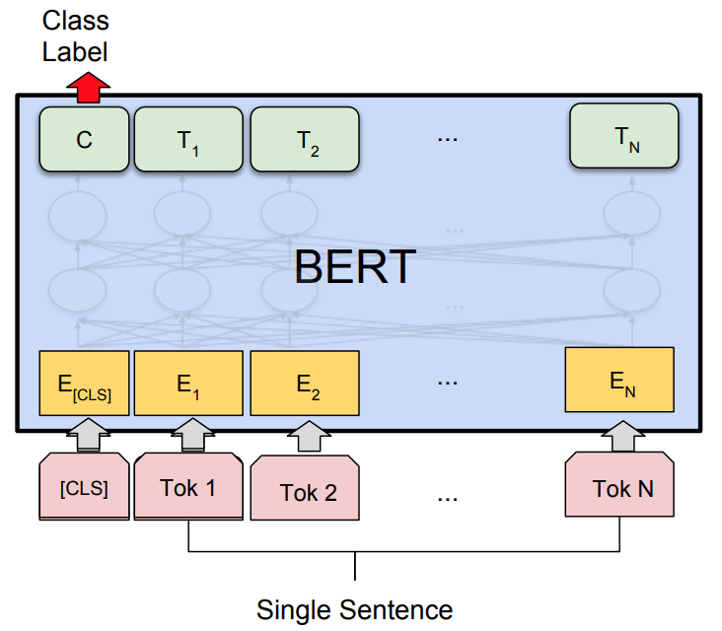
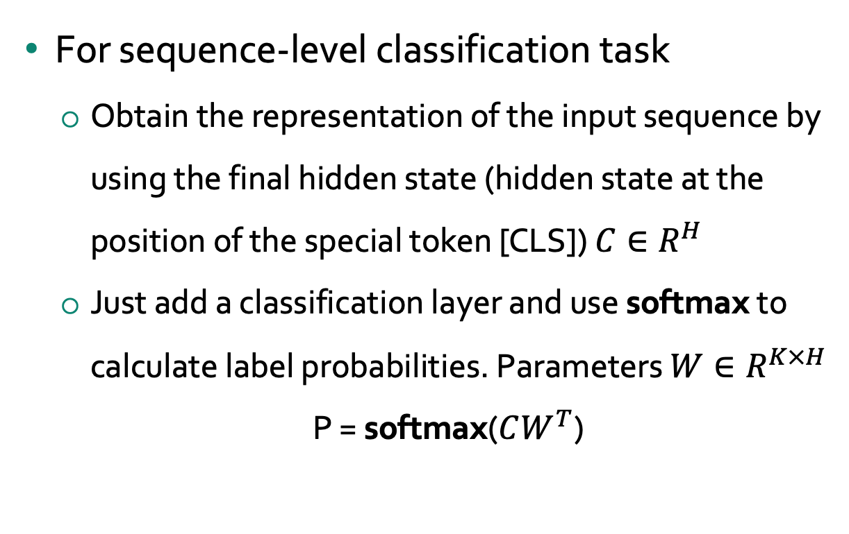
Fine-tuning procedure 1: Classification
For sequence-level classification task
  Obtain the representation of the input sequence by using the final hidden state (hidden state at the position of the special token [CLS]) $C∈R^{H}$
  Just add a classification layer and use softmax to calculate label probabilities. Parameters $W∈R^{K×H}$
  P = softmax($CW^{T}$)

Slide 22
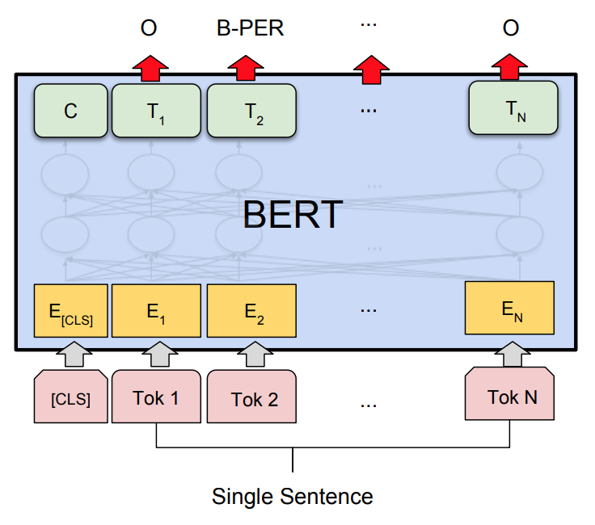
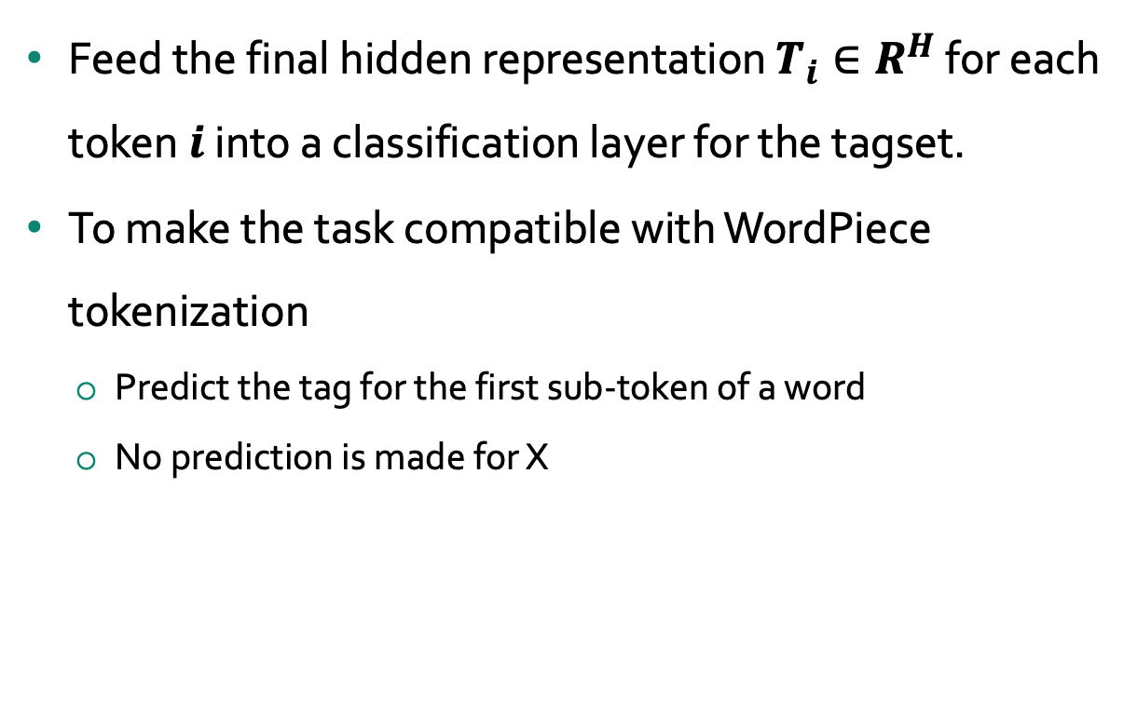
Fine-tuning procedure 2: Named Entity Recognition
Feed the final hidden representation $T_{i}∈R^{H}$ for each token $i$ into a classification layer for the tagset.
To make the task compatible with WordPiece tokenization
  Predict the tag for the first sub-token of a word
  No prediction is made for X
Jim | Hen | ##son | was | a | puppet | #er
I-PER | I-PER | X | 0 | 0 | 0 | X

Slide 23
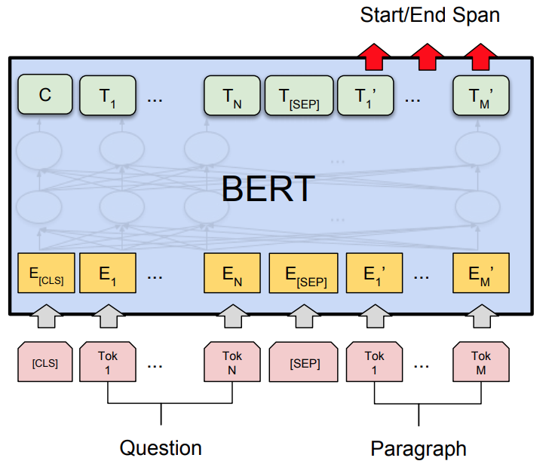
Fine-tuning procedure 3: Query Answering 1/2
Input Question:
Where do water droplets collide with ice crystals to form precipitation?
Input Paragraph:
.... Precipitation forms as smaller dropletscoalesce via collision with other rain dropsor ice crystals within a cloud. ...
Output Answer:
within a cloud

Slide 24
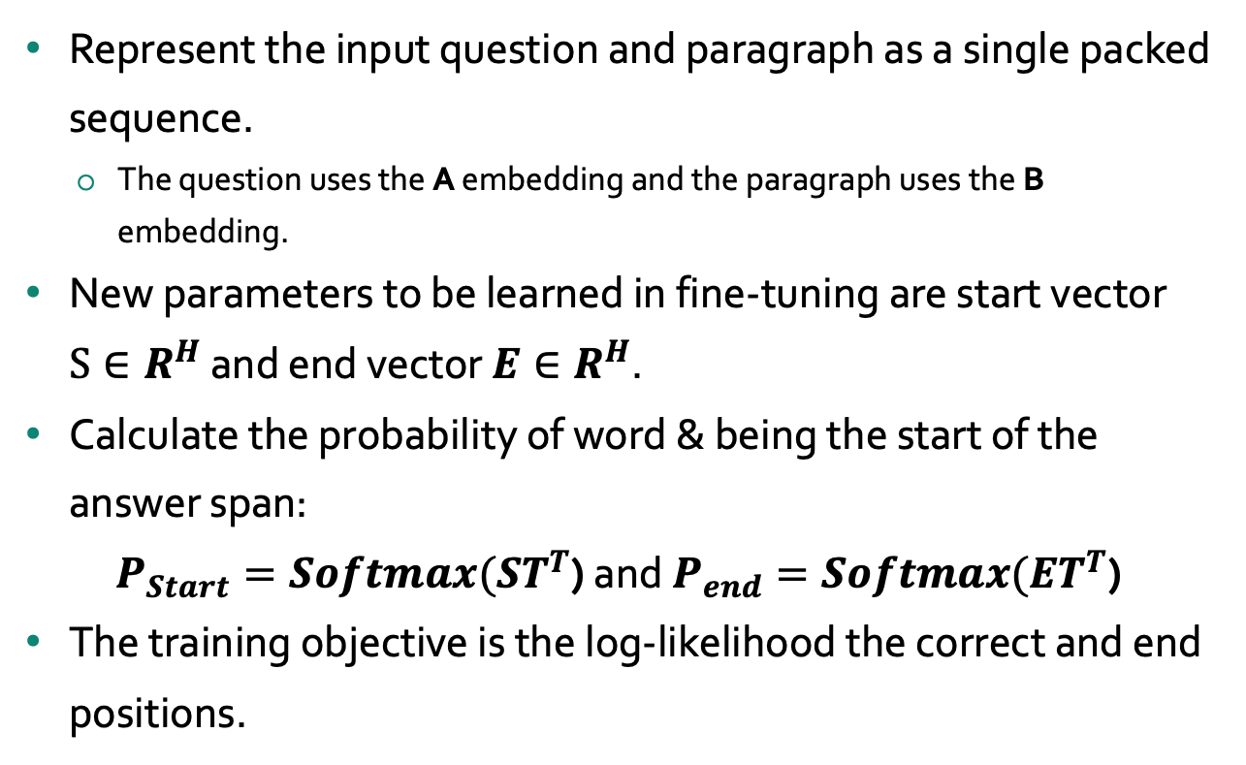
Fine-tuning procedure 3: Query Answering 2/2
Represent the input question and paragraph as a single packed sequence.
  The question uses the A embedding and the paragraph uses the B embedding.
New parameters to be learned in fine-tuning are start vector $S∈R^{H}$ and end vector $E∈R^{H}$.
Calculate the probability of word & being the start of the answer span:
$P_{Start}=Softmax(ST^{T}$) and $P_{end}=Softmax(ET^{T}$)
The training objective is the log-likelihood the correct and end positions.

Slide 25
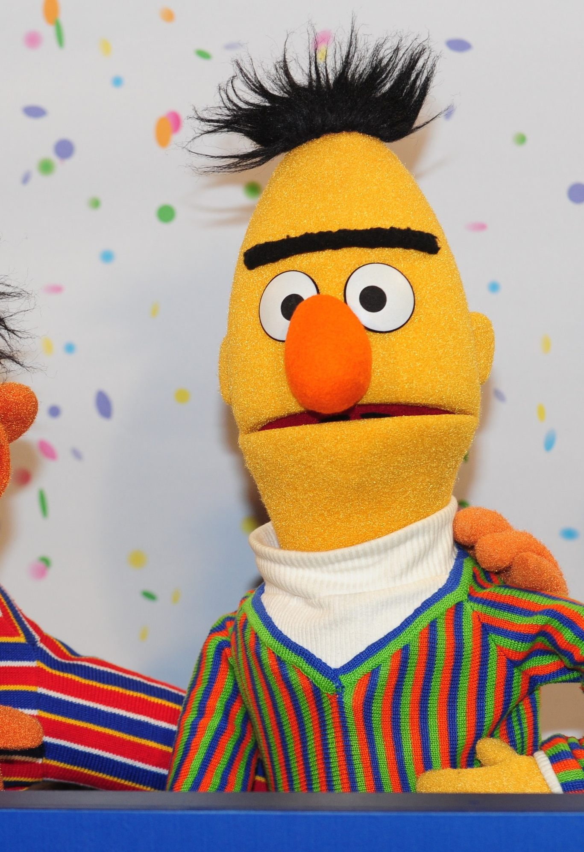
Experiments

Slide 26
Experiments
GLUE (General Language Understanding Evaluation) benchmark
  Distribute canonical Train, Dev and Test splits
  Labels for Test set are not provided
Datasets in GLUE:
  MNLI: Multi-Genre Natural Language Inference
  QQP: Quora Question Pairs
  QNLI: Question Natural Language Inference
  SST-2: Stanford Sentiment Treebank
  CoLA: The corpus of Linguistic Acceptability
  STS-B: The Semantic Textual Similarity Benchmark
  MRPC: Microsoft Research Paraphrase Corpus
  RTE: Recognizing Textual Entailment
  WNLI: Winograd NLI

Slide 27
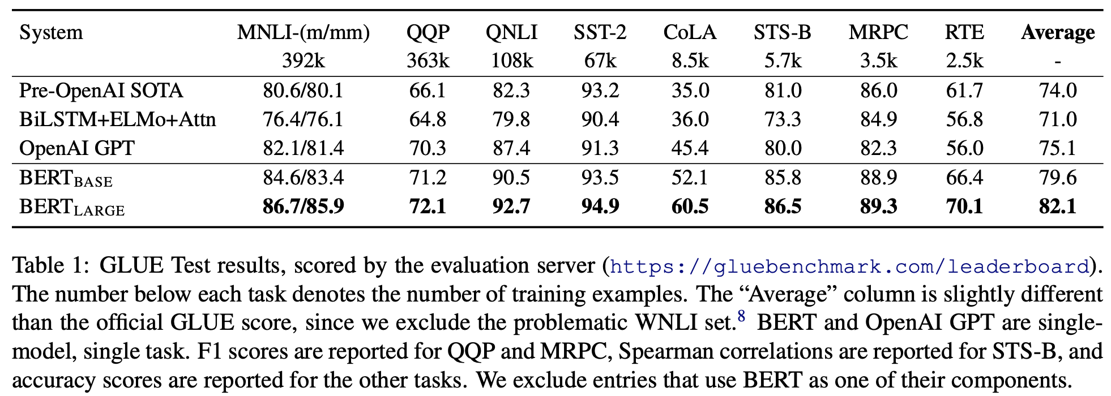
GLUE Results

Slide 28
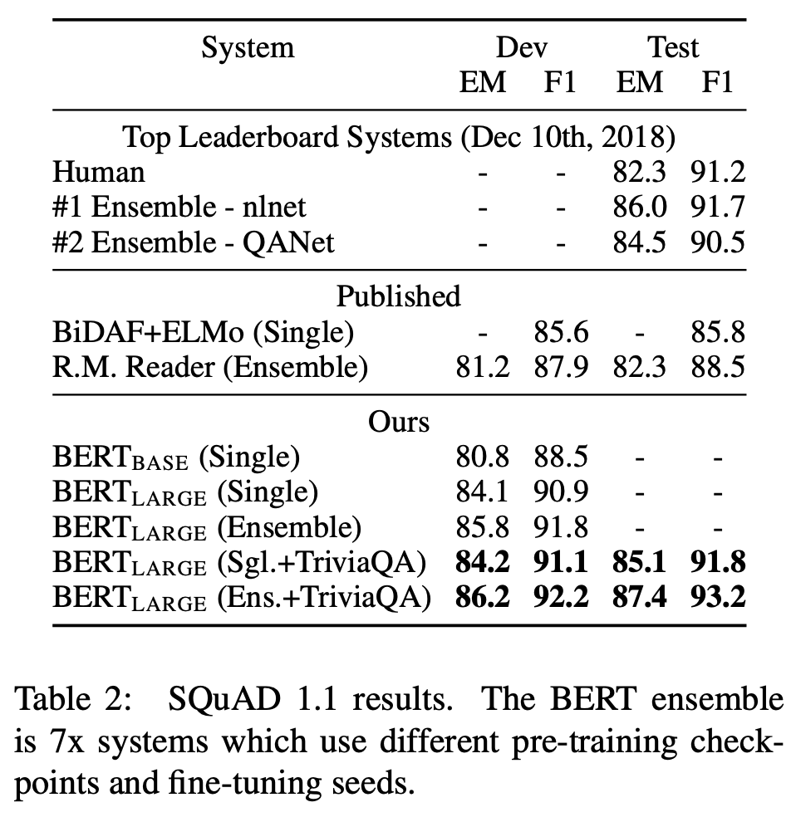
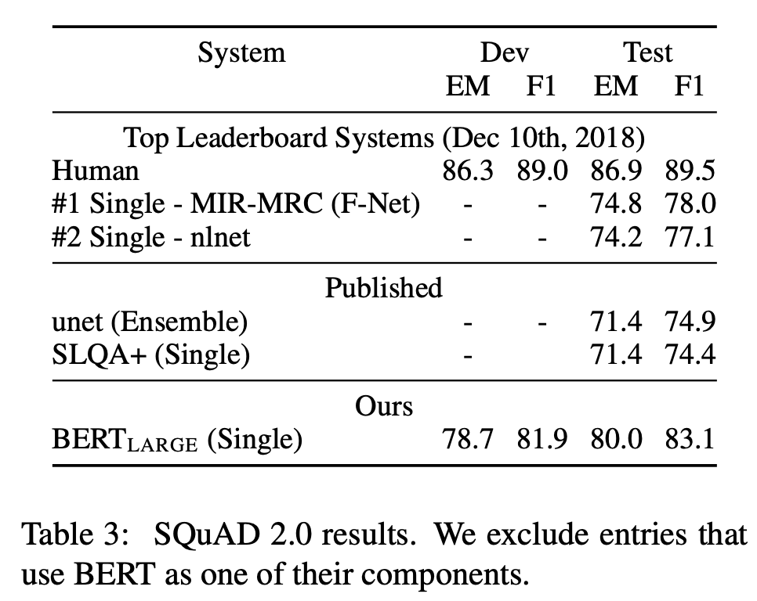
SQuAD: The Stanford Question Answering Dataset

Slide 29
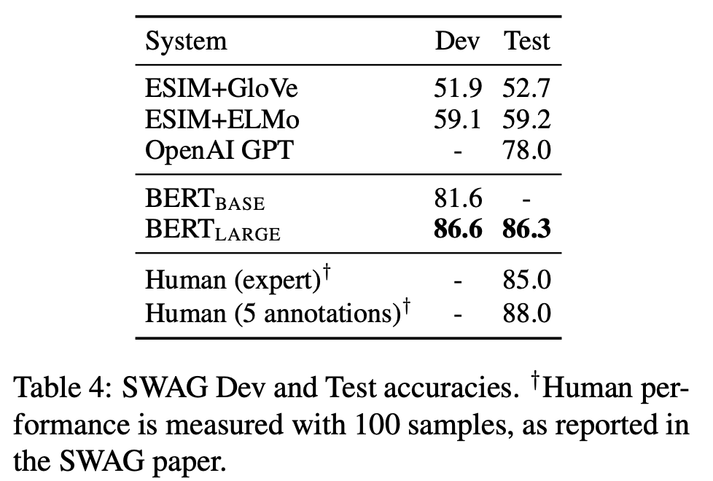
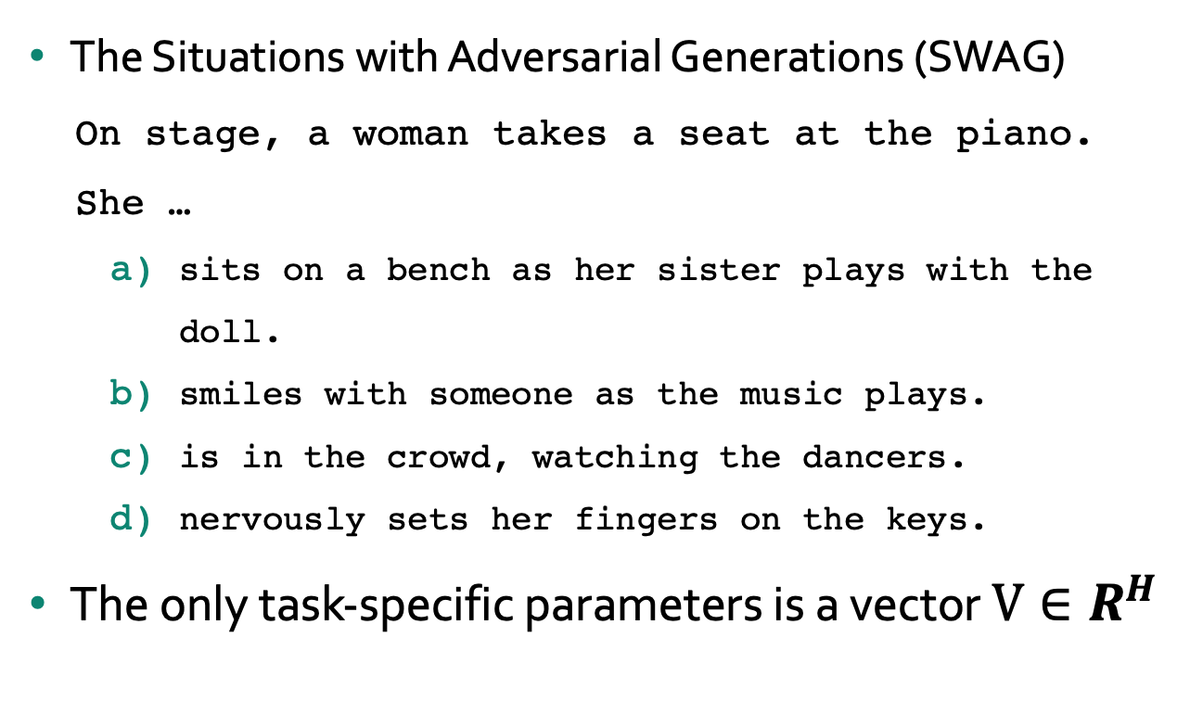
SWAG
The Situations with Adversarial Generations (SWAG)
  On stage, a woman takes a seat at the piano. She …
    sits on a bench as her sister plays with the doll.
    smiles with someone as the music plays.
    is in the crowd, watching the dancers.
    nervously sets her fingers on the keys.
The only task-specific parameters is a vector $V∈R^{H}$
The probability distribution is the softmax over the four choices

Slide 30
Conclusions
Unsupervised pre-training (pre-training language model) is increasingly adopted in many NLP tasks.
  Google Search is applying BERT models for search queries for over 70 languages.
Major contribution of the paper is to propose a deep bidirectional architecture from Transformer.
  Advance state-of-the-art for many important NLP tasks.
Cannot do everything in NLP!

Slide 31
Links
BERT: Pre-training of Deep Bidirectional Transformers for Language Understanding. Jacob Devlin Ming-Wei Chang Kenton Lee Kristina Toutanova.
BERT: Pre-training of Deep Bidirectional Transformers for Language Understanding Devlin et al., 2018 (Google AI Language). Presenter: Phạm Quang Nhật Minh NLP Researcher Alt Vietnam
The Illustrated BERT, ELMo, and co. (How NLP Cracked Transfer Learning). Jay Alammar. http://jalammar.github.io/illustrated-bert/
https://cs.uwaterloo.ca/~mli/cs886-002-2020.html
Other resources: http://primo.ai/index.php?title=Bidirectional_Encoder_Representations_from_Transformers_(BERT)
Programming:
  TensorFlow code and pre-trained models for BERT: https://github.com/google-research/bert
  PyTorch Pretrained Bert: https://github.com/huggingface/pytorchpretrained-BERT
  BERT-pytorch: https://github.com/codertimo/BERTpytorch
  BERT-keras: https://github.com/Separius/BERTkeras

Slide 32
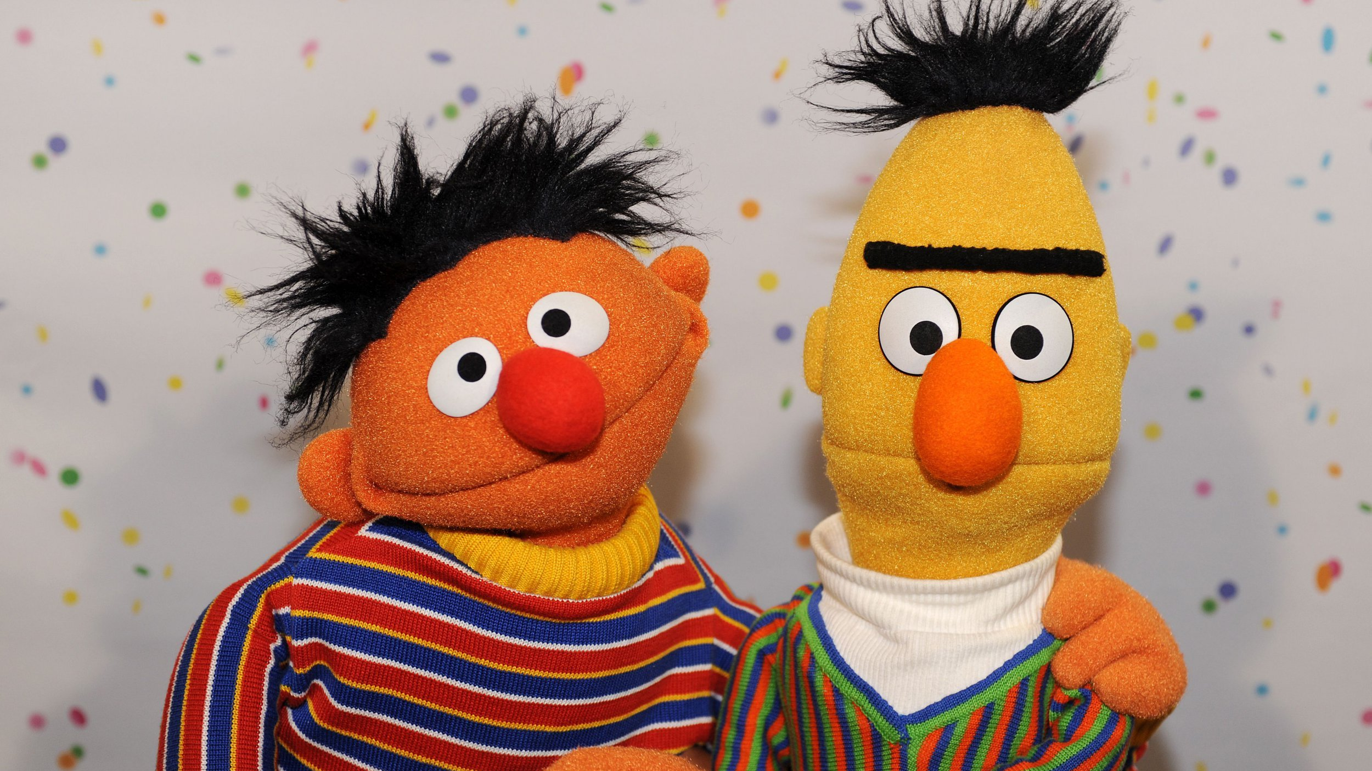
Question?
Slides available on:
https://personal-sites.deakin.edu.au/~mohamedb/teaching.html
* Bert is a Muppet who appears in numerous skits on the popular children's television show of the United States, Sesame Street.

